Slide 1
Black-Box Testing
Techniques

Slide 2
Black-Box Testing Techniques
A strategy in which testing is based on requirements and specifications
Applicability: All levels of system
development
Unit
Integration
System
Acceptance
inputs
Outputs

Slide 3
Black-Box Testing Techniques
Incorrect or missing functions
Interface errors
Performance error
inputs
Outputs

Slide 4
Black-Box Testing Techniques
Advantages: directs tester to choose subsets to tests that are both efficient and effective in finding defects
Disadvantages: never be sure of how much of the system under test (SUT) has been tested

Slide 5
Black-Box Testing Techniques
Exhaustive testing
Equivalence class testing (Equivalence Partitioning)
Boundary value analysis
Decision table testing
State-Transition testing

Slide 6
Exhaustive Testing
1.Definition: testing with every member of the input value space
2.Input value space: the set of all possible input values to the program

Slide 7
Consider an application in which a password field that accepts 3 characters, with no consecutive repeating entries. Hence, there are 26 * 26 * 26 input permutations for alphabets only. Including special characters and standard characters, there are much more combinations. So, there are 256 * 256 * 256 input combinations.

Slide 8
Equivalence Class Testing
EC Testing is when you have a number of test items (e.g. values) that you want to test but because of cost (time/money) you do not have time to test them all. Therefore you group the test item into class where all items in each class are suppose to behave exactly the same. The theory is that you only need to test one of each item to make sure the system works.
Example 1 Children under 2 ride the buss for free. Young people pay $10, Adults $15 and Senior Citizen pay $5. Classes: Price:0 -> Age:0-1 Price:10 -> Age:2-14 Price:15 -> Age:15-64 Price:5 -> Age:65-infinity

Slide 9


Equivalence Class Techniques
Taking each input condition and partitioning it into two or more groups:
Input Condition
range of values x: 1-50
Valid equivalence class
? < x < ?
Invalid equivalence classes
x < ?
x > ?

Slide 10
Equivalence Class -Limitations
It is most suited to systems in which much of the input data takes on values within ranges or within sets.
It makes the assumption that data in the same equivalence class is processed in the same way by the system

Slide 11
Maximum Defects occurs on Boundaries
Boundary Value Analysis

Slide 12
Boundary Value Analysis
Boundary value testing focuses on the boundaries simply because that is where so many defects hide. The defects can be in the requirements or in the code.
The most efficient way of finding such defects, either in the requirements or the code, is through inspection

Slide 13
Boundary Value Analysis
1.Identify the Ecs
2.Identify the boundaries of each EC
3.Create test cases for each boundary value by choosing one point on the boundary, one point just below the boundary, and one point just above the boundary

Slide 14
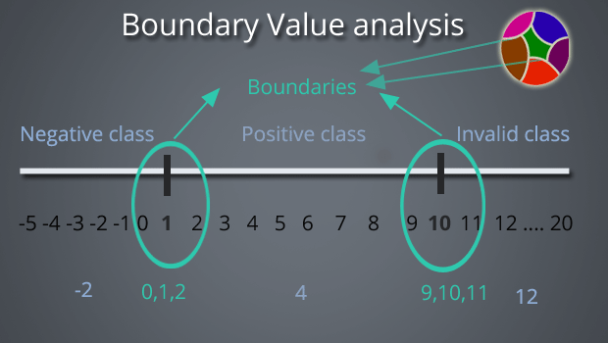

Slide 15
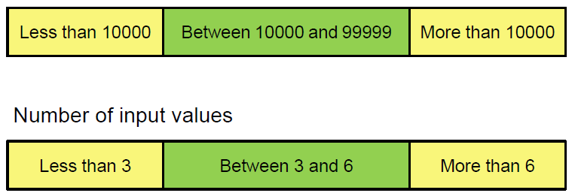
Boundary Value Analysis -Example
Specification: the program accepts three to six inputs which are 5 digit integers equal to or greater than 10000.
Input Values

Slide 16
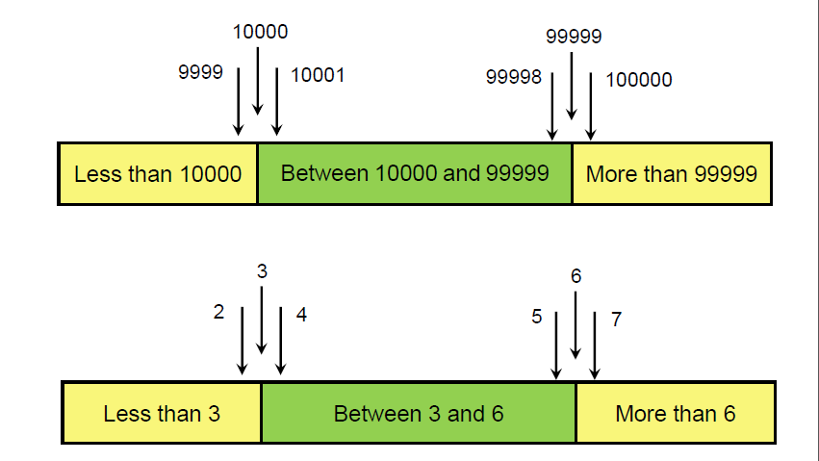
Boundary Value Analysis -Example

Slide 17
Boundary Value
Boundary value testing is equally applicable at the unit, integration, system, and acceptance test levels
All it requires are inputs that can be partitioned and boundaries that can be identified based on the system’s requirements

Slide 18

Don’t let your programmers check their own work; they’ll miss their own errors.

Slide 19
Decision Table Testing
An excellent tool for capturing certain kinds of system requirements and documenting internal system design
Record complex business rules that a system must implement
Also can serve as a guide to creating test cases

Slide 20
Decision Table Testing
Used to layout in tabular form all possible situations which a decision may encounter and to specify which action to take in each of these situations
A matrix representation of the logic of a decision
Specifies the possible conditions and the resulting actions

Slide 21
Decision Table Testing
Condition
Condition describe the conditions or factors that will affect the decision or policy
They are listed in the upper section of the decision table
Action
Action describe, in the form of statements, the possible policy actions or decisions
They are listed in the lower section of the decision table

Slide 22
Decision Table Testing
Rules
Rules describe which actions are to be taken under a specific combination of conditions
They are specified by first inserting different combinations of condition attribute values and then putting X's in the appropriate columns of the action section of the table

Slide 23
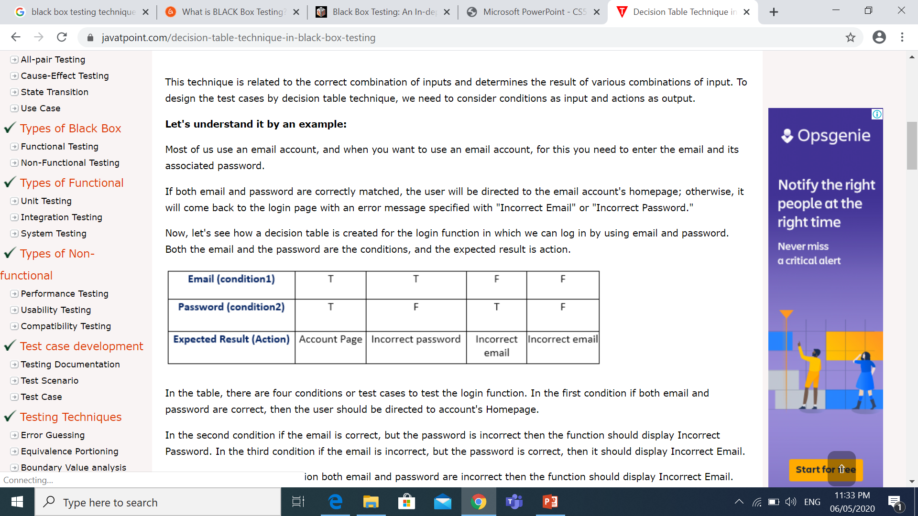
Decision Table
Most of us use an email account, and when you want to use an email account, for this you need to enter the email and its associated password.
If both email and password are correctly matched, the user will be directed to the email account's homepage; otherwise, it will come back to the login page with an error message specified with "Incorrect Email" or "Incorrect Password."

Slide 24
Decision Table Format
 | Rule 1 | Rule 2 | … | Rule P
Condition-1
Condition-2
…
Condition-M
Action-1
Action-2
…
Action-N

Slide 25
Decision Table Format
Inputs
Rule 1
Rule 2
…
Rule P
Condition-1
Condition-2
…
Condition-M
Action-1
Action-2
…
Action-N
Expected Results

Slide 26
Decision Table - Don’t Care Entry
 | Rule 1 | Rule 2 | Rule 3 | Rule 4
Condition-1 | T | F | F | F
Condition-2 | T | T | F | T
Condition-3 | T | F | T | T
Action-1 |  | _ | X | _
Action-2 | X |  | X
Action-3 |  | X |  | X
"don’t care" / "_" entry: the condition is irrelevant, or does not apply
Limited entry decision tables: all the conditions are binary
Extended entry decision tables: conditions are allowed to have
several values
Decision tables are deliberately declarative; no particular order is implied by the conditions, and selected actions do not occur in any particular order

Slide 27
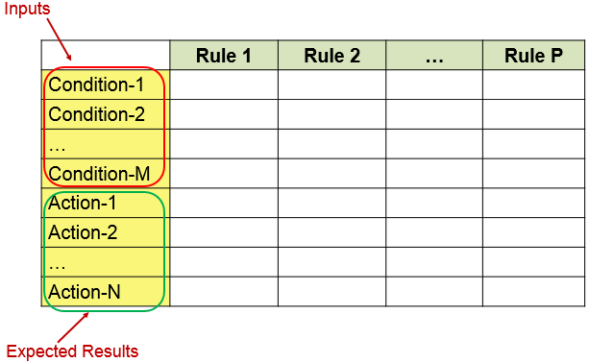
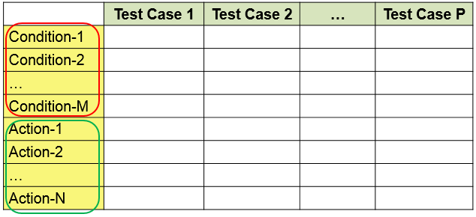
Decision Table vs Test Case Table
A decision table converted to a test case table:

Slide 28
Decision Table – Triangle Program
A program with three input integers, a, b, and c
If a triangle then integers a, b, and c must
satisfy:
a < b + c b < a + c c < a + b
Isosceles
Scalene (a ≠ b ≠ c)
Equilateral (a = b = c)

Slide 29
Decision Table – Triangle Program
 | Rule 1 | Rule 2 | Rule 3 | Rule 4 | Rule 5 | Rule 6 | Rule 7 | Rule 8 | Rule 9
C1: a, b, c form a triangle?
C2: a = b?
C3: a = c?
C4: b = c?
A1: Not a triangle
A2: Scalene
A3: Isosceles
A4: Equilateral
A5: Impossible

Slide 30
Decision Table – Triangle Program
 | Rule 1 | Rule 2 | Rule 3 | Rule 4 | Rule 5 | Rule 6 | Rule 7 | Rule 8 | Rule 9
C1: a, b, c form a triangle?
C2: a = b?
C3: a = c?
C4: b = c?
A1: Not a triangle
A2: Scalene
A3: Isosceles
A4: Equilateral
A5: Impossible
If not a triangle, pointless of looking at C2,C3, or C4 (rule 1)

Slide 31
Decision Table – Triangle Program
 | Rule 1 | Rule 2 | Rule 3 | Rule 4 | Rule 5 | Rule 6 | Rule 7 | Rule 8 | Rule 9
C1: a, b, c form a triangle? | N
C2: a = b? | _
C3: a = c? | _
C4: b = c? | _
A1: Not a triangle | X
A2: Scalene
A3: Isosceles
A4: Equilateral
A5: Impossible
If not a triangle, pointless of looking at C2,C3, or C4 (rule 1)

Slide 32
Decision Table – Triangle Program
 | Rule 1 | Rule 2 | Rule 3 | Rule 4 | Rule 5 | Rule 6 | Rule 7 | Rule 8 | Rule 9
C1: a, b, c form a triangle? | N
C2: a = b? | _
C3: a = c? | _
C4: b = c? | _
A1: Not a triangle | X
A2: Scalene
A3: Isosceles
A4: Equilateral
A5: Impossible
If not a triangle, pointless of looking at C2,C3, or C4 (rule 1)
If a=c and a=b then the negative entry in C4 is impossible (rule3)

Slide 33
Decision Table – Triangle Program
 | Rule 1 | Rule 2 | Rule 3 | Rule 4 | Rule 5 | Rule 6 | Rule 7 | Rule 8 | Rule 9
C1: a, b, c form a triangle? | N | Y | Y
C2: a = b? | _ | Y | Y
C3: a = c? | _ | Y | Y
C4: b = c? | _ | Y | N
A1: Not a triangle | X
A2: Scalene
A3: Isosceles
A4: Equilateral |  | X
A5: Impossible |  |  | X
If not a triangle, pointless of looking at C2,C3, or C4 (rule 1)
If a=c and a=b then the negative entry in C4 is impossible (rule3)

Slide 34
Decision Table – Triangle Program
 | Rule 1 | Rule 2 | Rule 3 | Rule 4 | Rule 5 | Rule 6 | Rule 7 | Rule 8 | Rule 9
C1: a, b, c form a triangle? | N | Y | Y | Y | Y | Y | Y | Y | Y
C2: a = b? | _ | Y | Y | Y | Y | N | N | N | N
C3: a = c? | _ | Y | Y | N | N | Y | Y | N | N
C4: b = c? | _ | Y | N | Y | N | Y | N | Y | N
A1: Not a triangle | X
A2: Scalene |  |  |  |  |  |  |  |  | X
A3: Isosceles |  |  |  |  | X |  | X | X
A4: Equilateral |  | X
A5: Impossible |  |  | X | X |  | X
If not a triangle, pointless of looking at C2,C3, or C4 (rule 1)
If a=c and a=b then the negative entry in C4 is impossible (rule3)

Slide 35
Decision Table vs Test Case Table
 |  | Rule 1 |  | Rule 2 |  | Rule 3 |  |  | Rule 4 | Rule 5 | Rule 6 | Rule 7 | Rule 8 | Rule 9
C1: a, b, c form a triangle?
C2: a = b?
C3: a = c?
C4: b = c?
A1: Not a triangle
A2: Scalene
A3: Isosceles
A4: Equilateral
A5: Impossible | Test Cas | e ID | a |  | b |  | c | Expected Output
23 | DT1
 | DT2
 | DT3
 | DT4
 | DT5
 | DT6
 | DT7
 | DT8
 | DT9

Slide 36
Decision Table vs Test Case Table
 |  | Rule 1 |  | Rule 2 |  | Rule 3 |  |  | Rule 4 | Rule 5 | Rule 6 | Rule 7 | Rule 8 | Rule 9
C1: a, b, c form a triangle? |  | F
C2: a = b? |  | _
C3: a = c? |  | _
C4: b = c? |  | _
A1: Not a triangle |  | X
A2: Scalene
A3: Isosceles
A4: Equilateral
A5: Impossible | Test Cas | e ID | a |  | b |  | c | Expected Output
24 | DT1 |  | 4 |  | 1 |  | 2 | Not a Triangle
 | DT2
 | DT3
 | DT4
 | DT5
 | DT6
 | DT7
 | DT8
 | DT9

Slide 37
Decision Table vs Test Case Table
 |  | Rule 1 |  | Rule 2 |  | Rule 3 |  |  | Rule 4 | Rule 5 | Rule 6 | Rule 7 | Rule 8 | Rule 9
C1: a, b, c form a triangle? |  | F |  | T |  | T
C2: a = b? |  | _ |  | F |  | T
C3: a = c? |  | _ |  | _ |  | F
C4: b = c? |  | _ |  | _ |  | _
A1: Not a triangle |  | X |  | X |  | X
A2: Scalene
A3: Isosceles
A4: Equilateral
A5: Impossible | Test Cas | e ID | a |  | b |  | c | Expected Output
25 | DT1 |  | 4 |  | 1 |  | 2 | Not a Triangle
 | DT2 |  | 1 |  | 4 |  | 2 | Not a Triangle
 | DT3 |  | 1 |  | 2 |  | 4 | Not a Triangle
 | DT4
 | DT5
 | DT6
 | DT7
 | DT8
 | DT9

Slide 38
Decision Table vs Test Case Table
 |  | Rule 1 |  | Rule 2 |  | Rule 3 |  |  | Rule 4 | Rule 5 | Rule 6 | Rule 7 | Rule 8 | Rule 9
C1: a, b, c form a triangle? |  | F |  | T |  | T |  |  | T
C2: a = b? |  | _ |  | F |  | T |  |  | T
C3: a = c? |  | _ |  | _ |  | F |  |  | T
C4: b = c? |  | _ |  | _ |  | _ |  |  | T
A1: Not a triangle |  | X |  | X |  | X
A2: Scalene
A3: Isosceles
A4: Equilateral |  |  |  |  |  |  |  |  | X
A5: Impossible | Test Cas | e ID | a |  | b |  | c | Expected Output
26 | DT1 |  | 4 |  | 1 |  | 2 | Not a Triangle
 | DT2 |  | 1 |  | 4 |  | 2 | Not a Triangle
 | DT3 |  | 1 |  | 2 |  | 4 | Not a Triangle
 | DT4 |  | 5 |  | 5 |  | 5 | Equilateral
 | DT5
 | DT6
 | DT7
 | DT8
 | DT9

Slide 39
Nondeterministic Table
Problem: when the action entries are different: e.g., when C1 is true and both C2 and C3 are false, both rules 4 and 9 are applicable. We can make two observations:
Rules 4 and 9 are inconsistent
The decision table is nondeterministic
Rules 4 and 9 are inconsistent because the action sets are different. The whole table is nondeterministic because there is no way to decide whether to apply rule 4 or rule 9
Thus care should be taken when don’t care entries used in a decision table

Slide 40
Nondeterministic Table
 | Rule 1 | Rule 2 | Rule 3 | Rule 4 | Rule 5 | Rule 6
C1 | T | F | F | F | F | T
C2 | _ | T | T | F | F | F
C3 | _ | T | F | T | F | F
A1 | X | X | X | _ | _ | _
A2 | _ | X | X | X | _ | X
A3 | X | _ | X | X | X | _

Slide 41
Nondeterministic Table
 | Rule 1 | Rule 2 | Rule 3 | Rule 4 | Rule 5 | Rule 6
C1 | T | F | F | F | F | T
C2 | _ | T | T | F | F | F
C3 | _ | T | F | T | F | F
A1 | X | X | X | _ | _ | _
A2 | _ | X | X | X | _ | X
A3 | X | _ | X | X | X | _

Slide 42
Applicability
Decision table testing can be used whenever the system must implement complex business rules when these rules can be represented as a combination of conditions and when these conditions have discrete actions associated with them

Slide 43
Task
Scenario: A marketing company wishes to construct a decision table to decide how to treat clients according to three characteristics:
Gender
City Dweller
age group: A(under 30), B(between 30 and 60), C(over 60)
The company has four products (W, X, Y and Z) to test market
Product W will appeal to male city dwellers.
Product X will appeal to young males.
Product Y will appeal to Female middle aged shoppers who do not live in cities.
Product Z will appeal to all but older males

Slide 44
1. Identify Conditions & Values
The three data attributes tested by the conditions in this problem are
Gender, with values M and F
City dweller, with value Y and N
Age group, with values A, B, and C

Slide 45
2. Compute Maximum Number of Rules
The maximum number of Rules is:
2 x 2 x 3 = 12

Slide 46
3. Identify Possible Actions
The four actions are:
Market product W
Market product X
Market product Y
Market product Z

Slide 47
3. Identify Possible Actions
 | R1 | R2 | R3 | R4 | R5 | R6 | R7 | R8 | R9 | R10 | R11 | R12
Gender | M | F | M | F | M | F | M | F | M | F | M | F
City | Y | Y | N | N | Y | Y | N | N | Y | Y | N | N
Age | A | A | A | A | B | B | B | B | C | C | C | C
 | A1 | A2 | A3 | A4 | A5 | A6 | A7 | A8 | A9 | A10 | A11 | A12
W | X |  |  |  | X |  |  |  | X
X | X |  | X
Y |  |  |  |  |  |  |  | X
Z | X | X | X | X | X | X | X | X |  | X |  | X

Slide 48
Advantage of decision table technique:
Any complex business flow can be easily converted into the test scenarios & test cases using this technique.
Such type of table are work iteratively, means the table created at the first iteration is used as input table for next tables. Such iteration can be carried out only if the initial table is unsatisfactory.
Simple to understand and everyone can use this method design the test scenarios & test cases.
It provide complete coverage of test cases which help to reduce the rework on writing test scenarios & test cases.
These tables guarantee that we consider every possible combination of condition values. This is known as its “completeness property”.

Slide 49

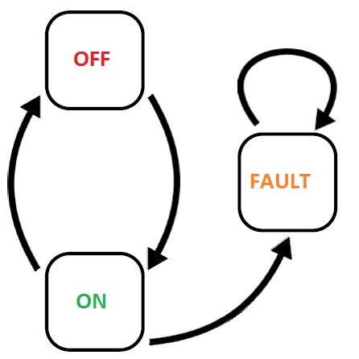
State-Transition Testing

Slide 50
State-Transition Testing
State-Transition diagrams are an excellent tool to capture certain types of system requirements and to document internal system design
These diagrams document the events that come into and are processed by a system as well as the system's responses

Slide 51
State-Transition Testing
When a system must remember something about what has happened before or when valid and invalid orders of operations exist, state-transition diagrams are excellent tools to record this information

Slide 52
State-Transition Testing
Models each state a system can exist in
Models each state transition
Defines for each state transition
Start State
Input
Output
Finish State

Slide 53
State-Transition Testing
State
Represented by a circle
A state is a condition in which a system is waiting for one or more events
States "remember" inputs the system has received in the past and define how the system should respond to subsequent events when they occur
These events may cause state-transitions and/or
initiate actions
State

Slide 54
State-Transition Testing
Transition
Represented by an arrow
A transition represents a change from one state to another caused by an event
Entry Point
The entry point on the diagram is shown by a black dot
Exit Point
The exit point is shown by a bulls-eye symbol

Slide 55
State-Transition Testing
Event
Smoke
Represented by a label on a transition
An event is something that causes the system to change state
Generally, it is an event in the outside world that
enters the system through its interface
Sometimes it is generated within the system
Events are considered to be instantaneous
Events may have parameters associated with them

Slide 56
State-Transition Testing
Action
Smoke / FireAlarm
Represented by a command following a "/"
An action is an operation initiated because of a state change
Often these actions cause something to be
created that are outputs of the system
Actions occur on transitions between states
The states themselves are passive

Slide 57
State-Transition Testing – Example
Input: Switch ON
Output:Light ON
OFF
Test Case 1 | Test Case 2
start state: OFF | start state: ON
input: switch ON | input: switch OFF
output: light ON | output: light OFF
finish state: ON | finish state: OFF
Input: Switch OFF
Output:Light OFF
ON

Slide 58
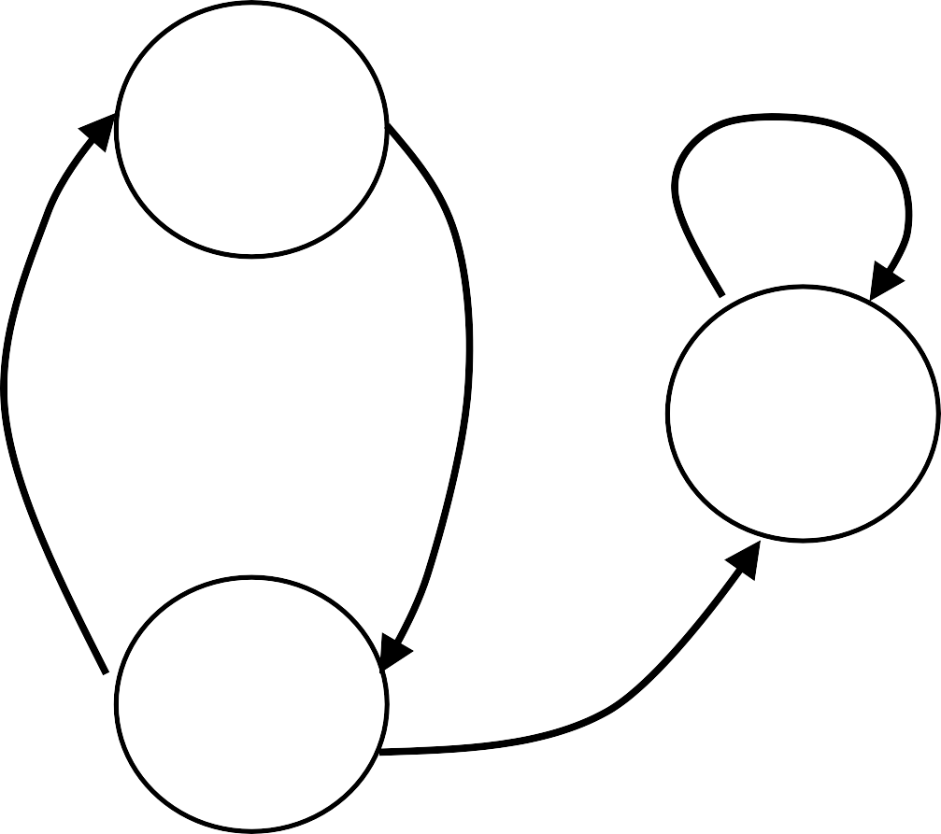
State-Transition Testing – Example
Input: Switch ON
Output:Light ON
OFF
Fault
Input: Switch OFF
Output:Light OFF
ON

Slide 59

State-Transition Testing – Example
OFF
OFF
ON
Fault
Fault
OFF
ON
ON

Slide 60
State-Transition Testing – Example
OFF
Fault
ON
 | Step 1 | Step 2 | Step 3
START STATE | OFF | ON | OFF
INPUT | Switch ON | Switch OFF | Switch ON
OUTPUT | Light ON | Light OFF | Light ON
FINISH STATE | ON | OFF | ON

Slide 61
Example 2 – Electronic Clock
A simple electronic clock has four modes, display time, change time, display date and change date
The change mode button switches between
display time and display date
The reset button switches from display time to adjust time or display date to adjust date
The set button returns from adjust time to
display time or adjust date to display date

Slide 62
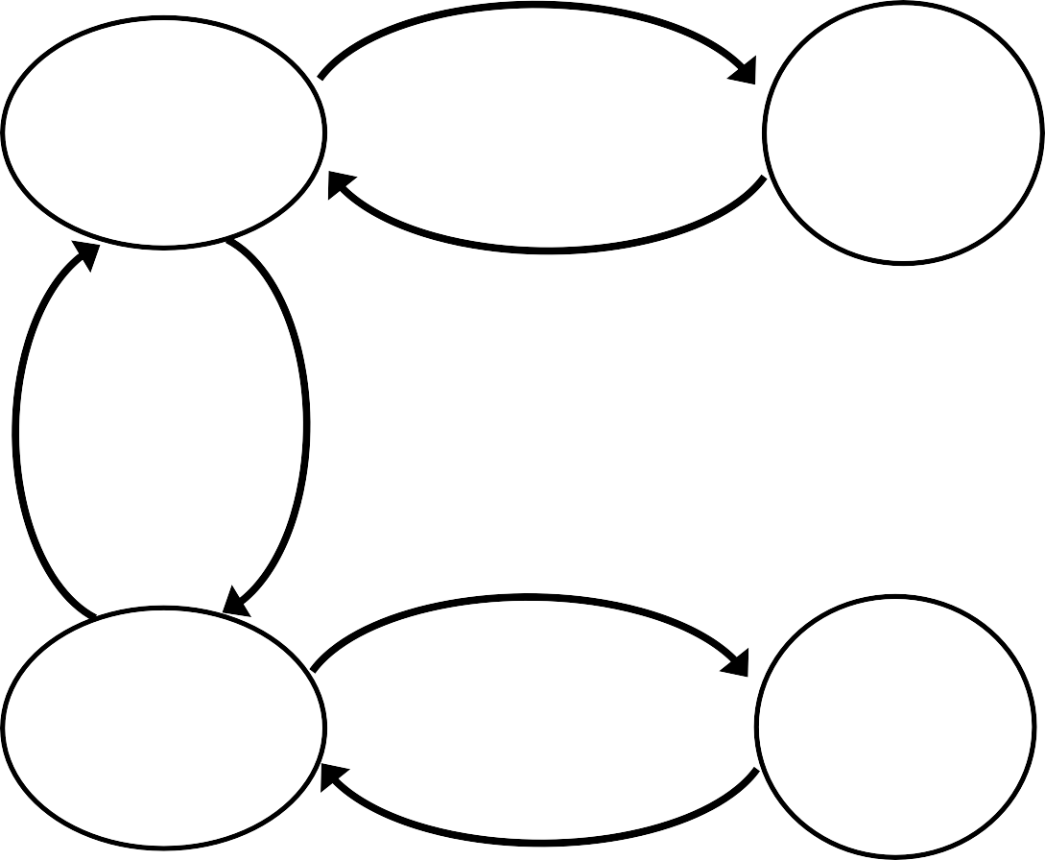
Example 2 – Electronic Clock
Reset
Display
Time
Adjust Time
Change Mode
Change Mode
Set
Reset
Display Date
Adjust Date
Set

Slide 63
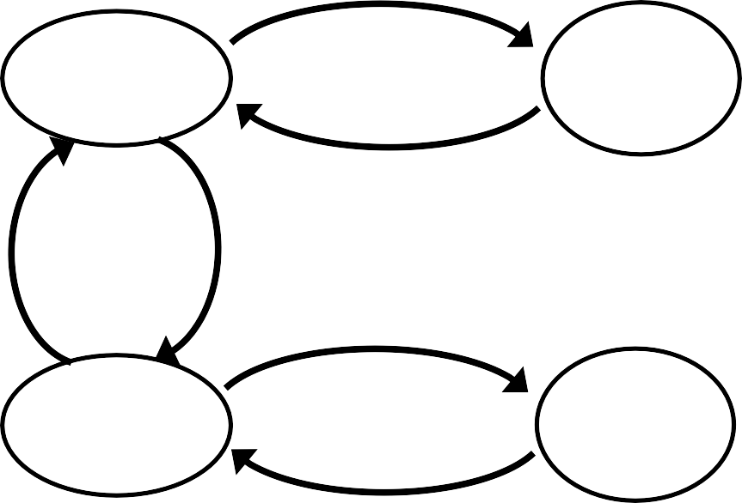
Example 2 – Electronic Clock
Display Time
Reset
Display Time
Adjust Time
Display Date
Adjust Time
Change Mode
Change Mode
Set
Reset
Display
Time
Adjust Date
Display
Time
Display Date
Adjust Date
Set
Display Date

Slide 64
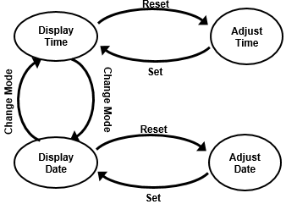

Example 2 – Electronic Clock
Test Case 1 | Step 1 | Step 2
START STATE | Display TIME | Display Date
INPUT | Change Mode | Change Mode
OUTPUT | Display Date | Display Time
FINISH STATE | Display Date | Display Time

Slide 65
Example 2 – Electronic Clock
Test Case 2 | Step 1 | Step 2 | Step 3
START STATE | Display Time | Display Date | Adjust Date
INPUT | Change Mode | Reset | Set
OUTPUT | Display Date | Adjust Date | Display Date
FINISH STATE | Display Date | Adjust Date | Display Date

Slide 66
Example 2 – Electronic Clock
Test Case 3 | Step 1 | Step 2
START STATE | Display Time | Adjust TIME
INPUT | Reset | Set
OUTPUT | Adjust TIME | DISPLAY Time
FINISH STATE | Adjust TIME | DISPLAY Time

Slide 67
Task
A cassette player has three operations: play, fast forward and fast play. Play and fast forward are activated using the play and fast forward button respectively. These operations can be cancelled using the stop button. When in play mode, the fast forward can be used to fast play. When in fast play mode, the fast forward button can be pressed again to enter fast forward or the stop button can be used to return to play.
When in fast forward the play button can be pressed to enter play mode directly.

Slide 68
Stress Testing
Stress testing is a software testing activity that determines the robustness of software by testing beyond the limits of normal operation. Stress testing is particularly important for "mission critical" software, but is used for all types of software. Stress tests commonly put a greater emphasis on robustness, availability, and error handling under a heavy load, than on what would be considered correct behavior under normal circumstances.

Slide 69
Fuzzy Testing
Fuzz testing is a software testing technique using which a random data is given as the inputs to the system.
If the application fails, then those issues/defects are to be addressed by the system. In short, unexpected or random inputs might lead to unexpected results.

Slide 70
Progressive Testing?
Progressive testing also known as incremental testing is used to test modules one after the other. When an application with a hierarchy such as parent-child module is being tested, the related modules would need to be tested first.
This progressive approach testing method has three approaches:
Top-down Approach
Bottom-up Approach
Hybrid Approach

Slide 71
Re-testing
Re-testing is executing a previously failed test against new software to check if the problem is resolved. After a defect has been fixed, re-testing is performed to check the scenario under the same environmental conditions.
During Re-testing, testers look for granular details at the changed area of functionality.

